Slide 1
MIDDLE STATES ACCREDITATION William Paterson University
Town Hall March 11, 2020
by Co-chairs, Dr. Sandra Hill & Dr. Jonathan Lincoln

Slide 2
Activities to date
Working groups collected data and wrote initial drafts of chapters, Fall 2019
MSCHE conference, Dec 2019 – 9 WP faculty and staff attended (Deans, UCC, SCPE, IE, AA, EM, President’s Office)
Steering Committee met Feb. 5, 2020 to kickoff spring 2020 work
Self-study draft – writing and revising continues spring 2020
Town Hall - March 11, 2020 Raubinger 101 – present Draft 1 Self-study to the WP community for review and feedback
Visiting Team Chair selected – Dr. William Fritz, President, College of Staten Island

Slide 3
Progression of Self-study – 3 Drafts -
Spring 2020:
Draft 1: Meeting the MSCHE standards’ criteria
Feedback solicited from the campus community –”filling in the gaps” on criteria
Feedback utilized in draft revisions
Spring 2020-Summer 2020
Draft 2: Telling our story
Revise and rewrite to create a narrative (Draft 2)
Construction of an interesting, clear, and compelling story
Summer 2020-Fall 2020
Draft 3: Rewriting and Revising our story
Visiting team chair preliminary visit, fall 2020
Final revisions per team chair in fall 2020
Submit self-study to MSCHE review team, early spring 2021

Slide 4
Expanding Use of Campus Labs for Assessment
Training in use of Campus Labs for program assessment & on- going assessment
Fall 2019:
5 workshops by IE for college and program assessment coordinators + individual sessions
writing a mission statement and measurable SLOs (student learning outcomes)
creating a curriculum map of courses for assessment
entering plans and SLOs into the Planning module in Campus Labs

Slide 5
Campus Labs Training & Use -continues-
Spring 2020
Continued IE-sponsored implementation sessions for uploading into Planning module (mission, goals, student learning outcomes)
All academic colleges are using Campus Labs for assessment documentation
Upload completion rates in Planning:
> 60% among all programs in 4 colleges
100% COE programs in Chalk & Wire system
GOAL 100% ALL
Training loading assessment data into Outcomes module – March 24-31, 2020
Work with non-academic units on assessment repository in Campus Labs -ongoing

Slide 6
Other Initiatives in the Works
Assessment of Assessment -- University Assessment Council composed of:
Academic Assessment Committee (AAC) (college assessment coordinators, UCC chair rep, IE, AA rep)
Administrative Assessment Committee (ADAC) (non-academic units, IE, AA)
Institutional Effectiveness Plan - how we assess, assess our assessment, and link assessment to planning and resource allocation

Slide 7
University Assessment Council Assessment of Assessment: Academic/Non-Academic (co-chairs of AAC, ADAC, Exec Dir IE)
Academic Assessment Committee (AAC)
college assessment coordinators
UCC chair rep
IE rep
AA rep
Administrative Assessment Committee (ADAC)
non-academic unit reps
IE rep
AA rep

Slide 8
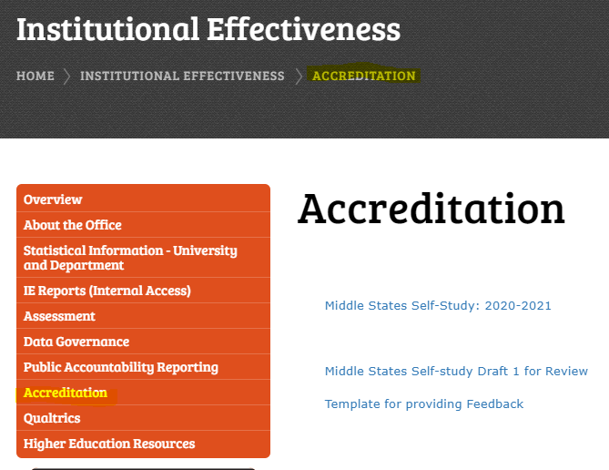
Your Homework! Feedback on Draft 1 – Mar 11-Apr 6,2020
Access draft 1 and feedback survey at
https://www.wpunj.edu/institutional-effectiveness/accreditation/

Slide 9
Welcome Questions or Comments
Contact: Sandra Hill (hills21@wpunj.edu)
Or
Jonathan Lincoln (lincolnj@wpunj.edu)

